Slide 1
Lecture 3:
Global Environmentalism – II
Course: Environment and Politics in India

Slide 2
‘Environment’ in Sociological Theory
Persisting environmental catastrophe and responses:
What did Marx, Weber and Durkheim have to say?
  Weber: Nothing at all about the natural world.
  Durkheim: Recognises historical change, role of human-nature relationship. But NO theoretical analysis of impacts of social/economic processes on nature.
  Marx and Engels: Man-nature dialectic, Role of labour in transforming nature, alienation from nature.
  Extending Marx/Marxism: Nature is ‘historically produced’.
  Modern sociology and environmental theory
Anthony Giddens: Need to move beyond the capitalism/industrialism debate. Capitalism + Industrialism -> Ecological catastrophe
Ulrich Beck: Risk Society. Institutionalized response to old/NEW risks, no individual/institutional RESPONSIBILITY/accountability. “Organized irresponsibility” and its social/political impacts.

Slide 3
‘Environment’ in Sociological Theory
Social Theory on Environment and Politics:
Giddens: Environmental movements as “politics mobilised by ideal values and moral imperatives”.
Habermas: Environmental movements as “response of the life world to its colonization”.
Need to DEMOCRATIZE state-citizen relationship.
  Limitations of representative democracy.
  Role of “civil society”, emergence of new local/regional/national/international groups.
  Habermas and the need for rational democratic discourse in the ‘public sphere’.
  Beck, ‘ecological democracy’ and the need to politicize policy-making spaces.

Slide 4
Roots of Western Environmentalism
THREE factors contributing to the WESTERN debate on environmental ethics:
Lynn White’s indictment of Christianity (Historical Roots of our Ecological Crisis). Self-reflection, self-scrutiny.
John Muir’s indictment of “philistinism” and “commercialism”. Against equating “America” with the $. Beginnings of the “wilderness” movement.
The character of temperate ecosystems. NOT the “wild”/cruel/difficult tropical ecosystem.
Made it easy to romanticize “nature”.
LYNN WHITE:
The Bible asserts man's dominion over nature and establishes a trend of anthropocentricism.
Christianity makes a distinction between man (formed in God's image) and the rest of creation, which has no "soul" or "reason" and is thus inferior.

Slide 5
THREE Environmental Utopias
Responding to Industrialization: GLOBAL/Western Trends in the Environmental Movement
AGRARIANISM:
Ideal civilization: GO BACK TO THE LAND
  Grain-based
  Peasant society
  Technology is human-scale
  Strong bonds of community
  Harmonious relationship between village and town
  Village -> Food, health, social bonding
  Town -> Wealth, knowledge, energy
Both TRIBAL and INDUSTRIAL societies are not good.
KEY thinkers: Gandhi, Tagore, Thomas Jefferson

Slide 6
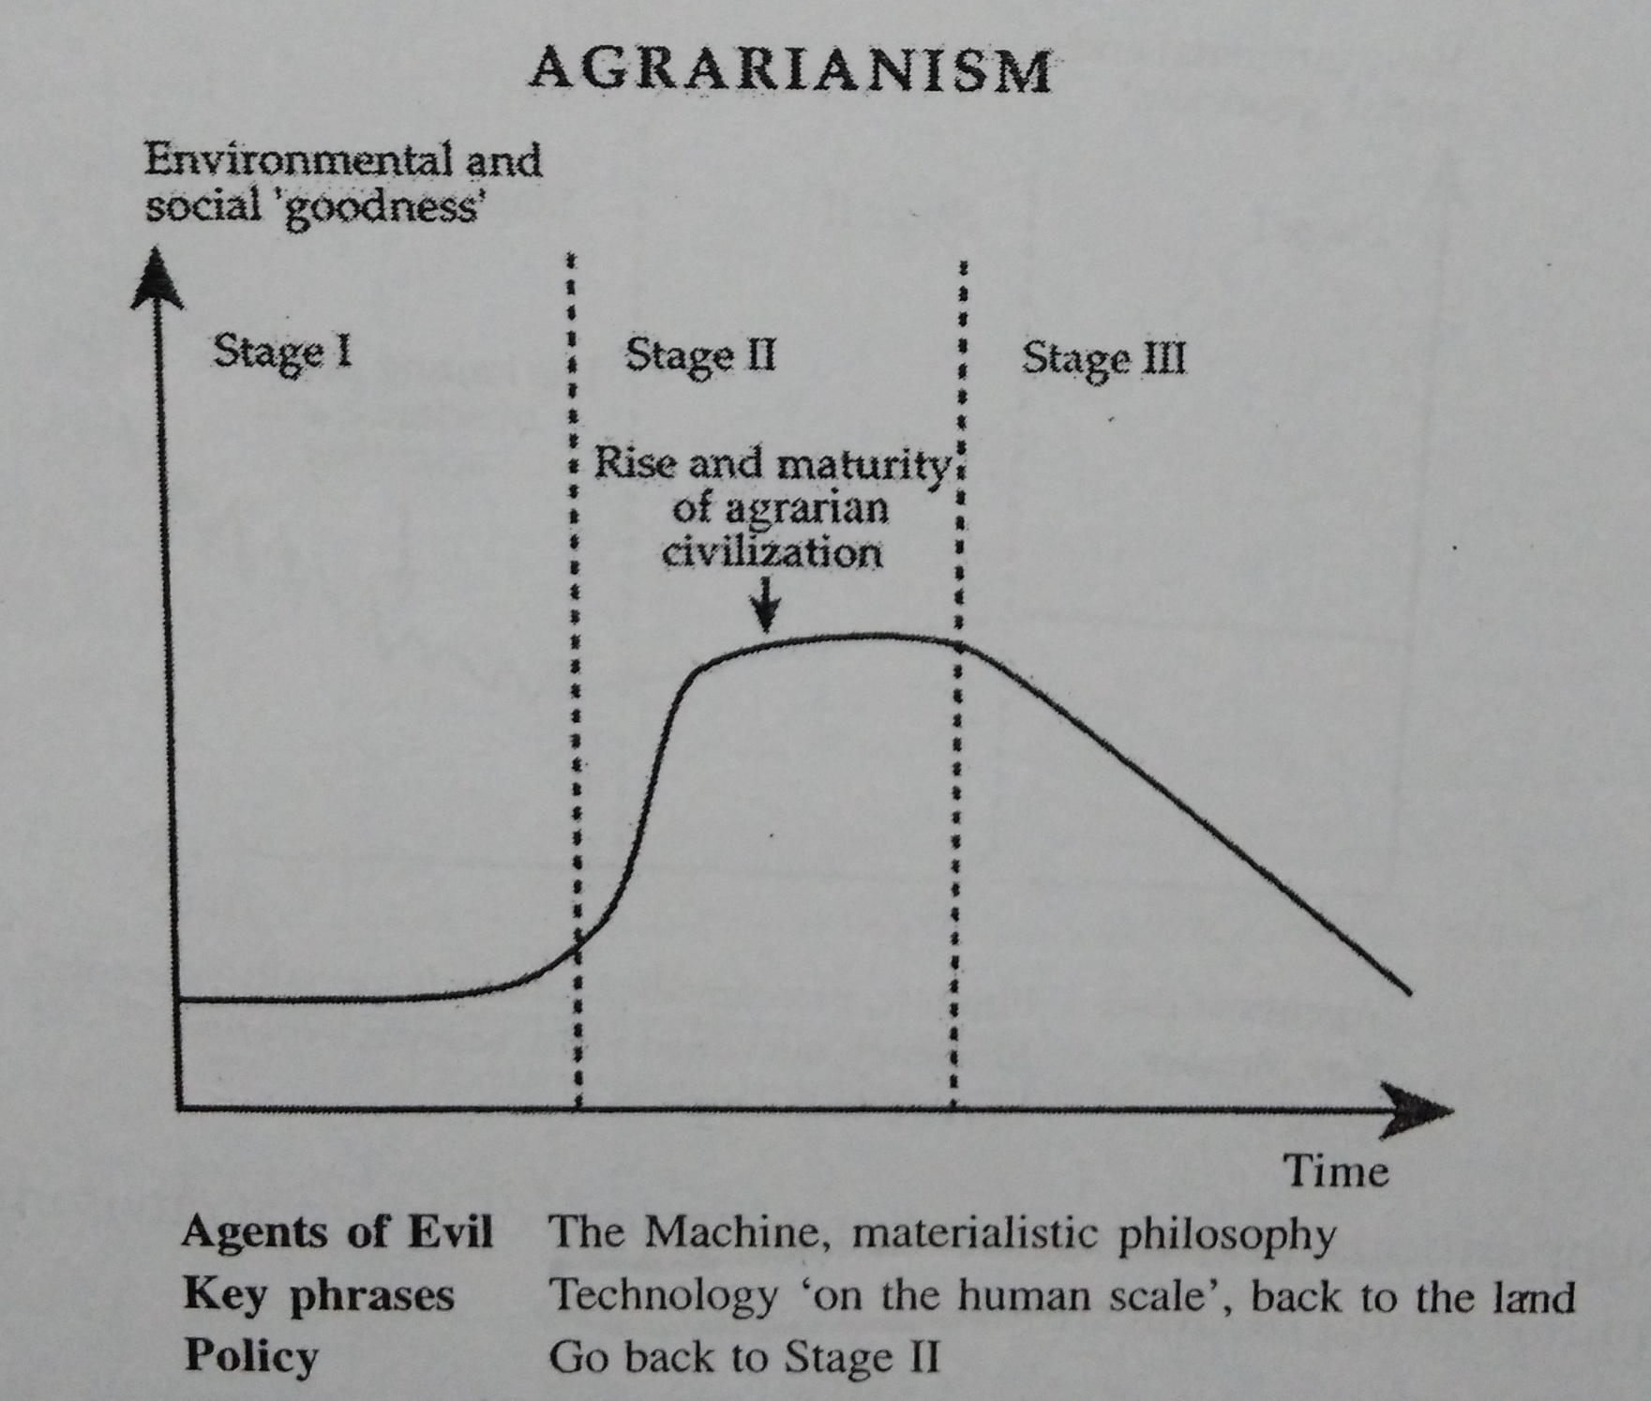

Slide 7
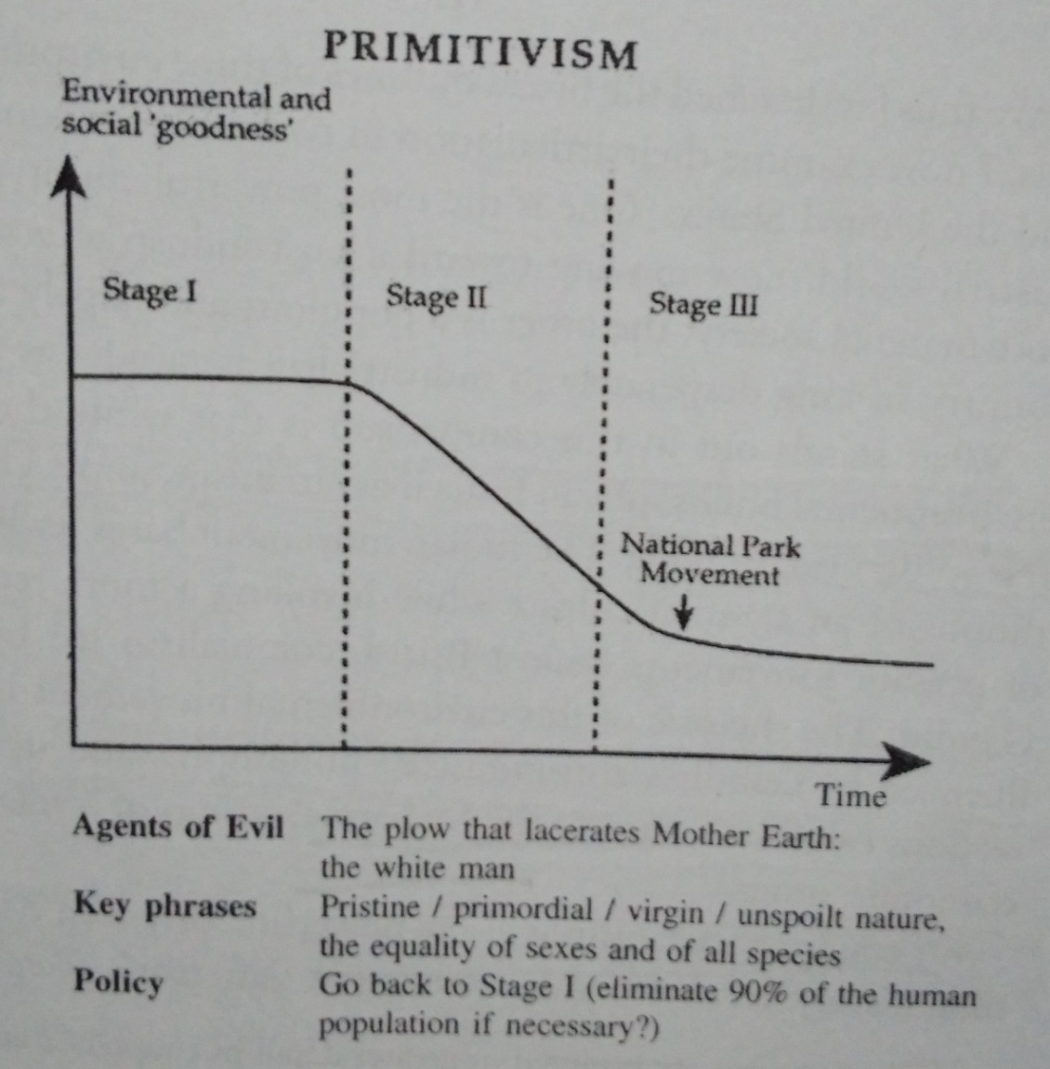
THREE Environmental Utopias
WILDERNESS/PRIMITIVISM
Ideal civilization:
  Pre-agrarian, tribal Society, rudely interrupted by the white man/colonialism
  Forest-based, hunter-gatherer
  Low-level technology. No use of ploughs/industrialism
  Strong bonds of community

Slide 8
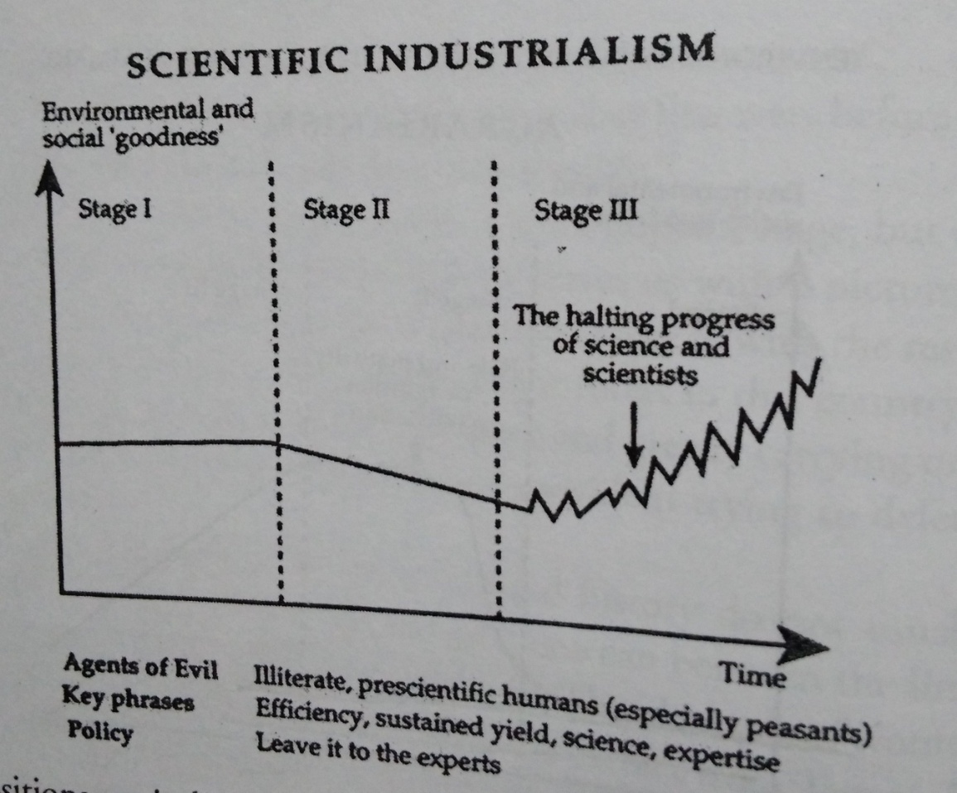
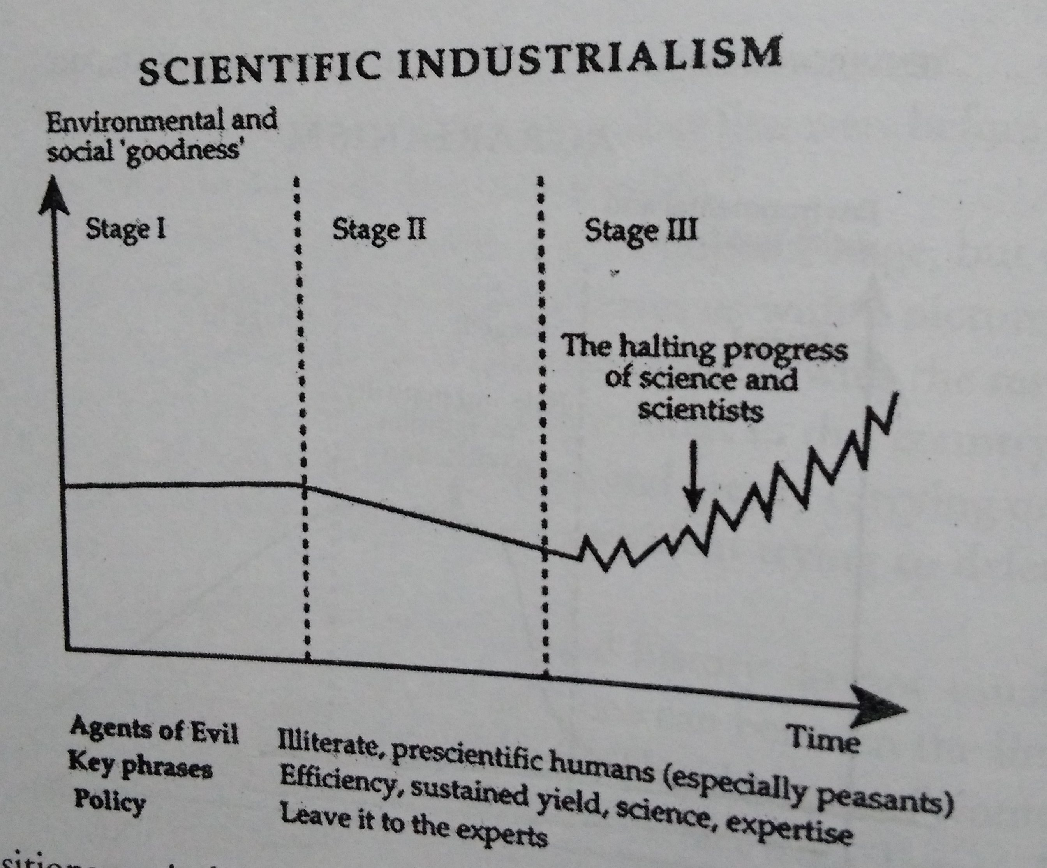
THREE Environmental Utopias
SCIENTIFIC INDUSTRIALISM
Ideal civilization:
  Industrial society
  Tamed industrialism
  Rejects ‘anarchy’ of the market
  ‘Rational’ program of state control
  Legislations/activist State

Slide 9
THREE Environmental Utopias
All three trends COULD represent three perspectives on the human-nature relationship.
Scientific study/Conquest of nature
Human submission to “natural processes”
A golden mean of “stewardship” and “sustainable use”
DOMINANT Models of environmentalism?
US: Wilderness. Preservationism versus Utilitarianism
India: Agrarianism. Subsistence versus Commerce, Local versus national, peasants versus industry
In BOTH India and the US, SCIENTIFIC INDUSTRIALISM is the enemy of the environmental movement.

Slide 10
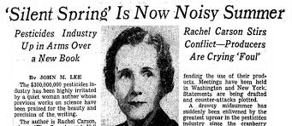
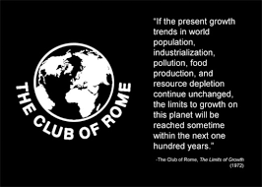
Landmarks in Global Environmentalism
1962: Rachael Carson’s Silent Spring
1972: Club of Rome’s Limits to Growth study
1972: UN conference on environment at Stockholm
1973: Schumacher’s Small is Beautiful
1977: Hirsh’s The Social Limits to Growth
1983: Establishment of the World Commission on Environment and Development (known as the Brundtland Commission).
1987: Brundtland Commission’s Our Common Future

Slide 11
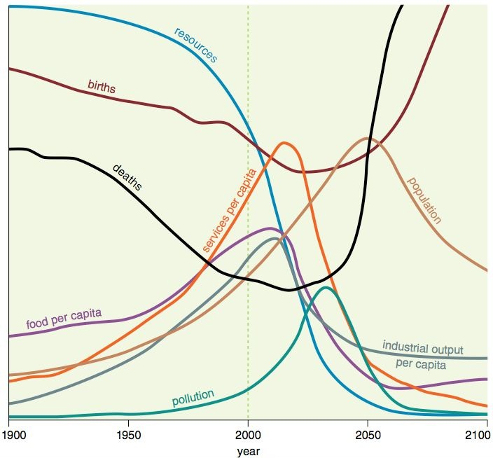

Slide 12
Landmarks in Global Environmentalism
How should the ‘third’ world respond to global environmentalism?
Is environmentalism simply a tool to stop ‘development’ in poor/developing countries?
Does ‘pollution’ exist ONLY in the poor countries?
EXAMPLES: Responses from Brazil, India, UK, US.
ANIL AGARWAL:
Roots of western environmental problems:
  Issues of WASTE DISPOSAL. Air/Water pollution, toxic industrial/nuclear wastes.
  Need to PRESERVE landscapes/species.
Roots of Third World environmental problems:
  Lack/Misuse of resources – forests, soil, water
  Need to provide for domestic/Western industry. EXAMPLE: Japan’s Timber requirements.

